Slide 1
Basic Data Analytics
Mr. Shrikrishna Anand Narvekar
Assitant Professor
Computer Engineering department
Agnel Institute of Technology and Design

Slide 2
Content
Need for Data Analytics Life cycle
Key roles of successful Analytics Project
Phases of data analytics lifecycle

Slide 3
Introduction
What is Data Analytics Lifecycle?
It is a step-by-step roadmap that guides how we handle data — from understanding a problem, collecting and cleaning data, building models, checking results, and finally using those results in real life.
Just like any big project (for example, building a house or developing an app), data analytics also needs a proper plan and sequence of steps — that’s what the lifecycle gives us.

Slide 4
Need of data Analytics Lifecycle
Bring order and disciple to exploratory work
the lifecycle gives structure to your analytics work — so you don’t jump into coding or analyzing data without knowing the goal.
2. Improve reproducibility & consistency
Why it matters: If another analyst works on the same problem, they should get similar results using the same steps.
Every phase is documented (data cleaning, modeling, testing), so others can repeat or verify it.
Notes:
Example: A company analyzing customer complaints first defines the problem (“reduce complaints by 20%”) before collecting and cleaning data. This keeps the project focused.
Example: A hospital that builds a model to predict heart disease documents each step — so another branch can reproduce the same study later.

Slide 5
3. Align Analytics with business goals
Problem: Many projects fail because the analysis doesn’t solve the real business problem.
With a lifecycle: The first phase, Discovery, ensures you understand what the organization actually wants.
4. Manage risk and ensure quality
Without checks: Wrong data or errors in the model can lead to bad decisions.
With a lifecycle: Each stage includes testing, validation, and feedback.
5. Support scalability and maintenance
Why it matters: Models need to be updated as new data comes in.
With a lifecycle: The “Operationalization” phase ensures the system can grow, be monitored, and improved.
Notes:
3. Example: A retail chain wants to increase sales. Instead of just analyzing “total revenue,” the team first defines the goal — “recommend products to repeat customers.” The lifecycle ensures clarity.
Example: A bank uses customer data to approve loans. The lifecycle ensures they check data accuracy and test models before deployment, reducing the risk of wrong approvals.
Example: Netflix’s recommendation system is updated daily with new viewing data — that’s part of lifecycle maintenance.

Slide 6
6. Clarify team roles & coordination
Why: Data analytics projects involve many people — data engineers, analysts, scientists, business managers.
Everyone knows what to do at each stage.
7. Improve communication & change management
Why: Results are meaningful only when non-technical people understand them.
“Communicating Results” phase ensures insights are shared clearly with managers and decision-makers.
8. Enable continuous improvement
Why: No model is perfect forever — business goals and data change.
You can go back, refine data, rebuild the model, and keep improving.
Notes:
6.Example: In a telecom company:
Data engineers prepare call data
Data scientists build churn models
Business heads interpret results and plan offers.
7.Example: A data team presents customer insights to marketing in simple dashboards — helping them plan better ad campaigns.
8. Example: A food delivery app analyzes delivery times. After using the model for a month, they find new patterns and refine the model — improving accuracy over time.

Slide 7
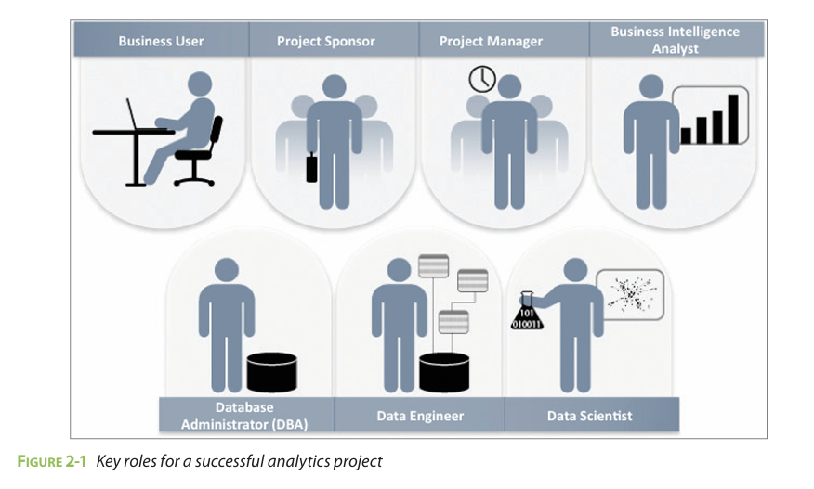
Key roles of successful analytics Project

Slide 8
Business Users: Someone who understands the domain area and usually benefits from the results. This person can consult and advise the project team on the context of the project, the value of the results, and how the outputs will be operationalized.
Project sponsor: Responsible for the genesis of the project. The boss or initiator of the project — the person who funds and supports it.
What they do:
Defines why the project is needed and what problem it should solve.
Provides the budget and resources.
Measures the value of the project after it’s completed.

Slide 9
Project Manager
The organizer — ensures everything happens on time and everyone knows their tasks.
What they do:
Plans timelines and milestones.
Tracks progress and ensures quality work.
Communicates with all team members.
Business Intelligent Analyst
A data storyteller who turns raw data into understandable reports and dashboards.
Knows company data sources very well.
Builds charts, graphs, and dashboards to show business performance (KPIs).
Helps management make data-driven decisions.
Example:
A BI Analyst might create a dashboard showing monthly sales by region using tools like Power BI or Tableau.

Slide 10
Database Administrator
The caretaker of databases — makes sure data is stored safely and accessible to the team.
What they do:
Sets up and maintains the database system.
Controls who can access which data.
Ensures data security and backups.
Example:
A DBA ensures that the sales database is secure and that the data scientist can access it safely without affecting live operations.

Slide 11
Data Engineer
The builder and plumber of the data system — makes sure the data flows smoothly from sources to analysis.
Extracts data from multiple sources (databases, APIs, files).
Cleans, transforms, and loads it into a usable form (data pipeline).
Works closely with data scientists to prepare the data for modeling.
Example:
A Data Engineer combines data from website clicks, customer orders, and feedback forms into one clean dataset for analysis.

Slide 12
Data Scientist
The brain of the analytics project — uses math, statistics, and coding to find patterns and make predictions.
Applies analytical and machine learning techniques.
Builds and tests predictive models.
Interprets results and provides insights to the business team.
Example:
A Data Scientist might create a model that predicts which customers are most likely to cancel their subscription.

Slide 13
Phases of data analytics lifecycle
Phase 1: Discovery
Phase 2: Data Preparation
Phase 3: Model Planning
Phase 4: Model Building
Phase 5: Communicate Results
Phase 6: Operationalize

Slide 14
Phase 1: Discovery
In this phase, the team learns about the business domain and understands the problem that needs to be solved.
They check if similar projects were done before and what lessons can be learned.
They also identify the resources available — such as data, time, tools, and people.
The main goal here is to clearly define the business problem as an analytics task and make initial assumptions or hypotheses to test later.

Slide 15
Phase 2: Data Preparation
Here, the team sets up a sandbox environment — a safe workspace for data exploration and analysis.
They collect data from different sources and perform ETL (Extract, Transform, Load) or ELT (Extract, Load, Transform) operations to clean and organize it.
The team makes the data ready for analysis by removing errors, filling missing values, and ensuring it is in the right format.

Slide 16
Phase 3: Model Planning
In this phase, the team decides which methods, tools, and techniques to use for building the model.
They explore the data to understand the relationships between different variables and then select the most important ones.
They also plan the overall workflow for the next phase.

Slide 17
Phase 4: Model Building
Now, the actual model creation begins.
The team divides the data into training, testing, and production sets.
They use the selected techniques to build and run models, and check whether their tools and systems are powerful enough (for example, whether faster hardware or parallel processing is needed).

Slide 18
Phase 5: Communicate Results
After the models are tested, the team evaluates whether the project met the goals defined in Phase 1.
They summarize key findings, measure the business value, and prepare reports or presentations to explain the results clearly to stakeholders in simple language.

Slide 19
Phase 6: Operationalize
In the final phase, the team delivers all final reports, codes, and documentation.
Sometimes a pilot project is run to test the model in real-world conditions.
The main focus is to ensure the model adds real value to the organization and that the results are easy for the audience to understand and apply.

Slide 20
Different activities performed at Discovery phase of Data Analytics
Learning the business domain
Assessing Resources
Framing the Problem
Identifying Key Stakeholders
Interviewing the Analytics Sponsor
Developing Initial Hypotheses
Identifying Potential Data Sources

Slide 21
Different activities performed at Data Preparation phase of Data Analytics
Preparing the Analytic Sandbox
Performing ETLT (Extract, Transform, Load, Transform)
Learning About the Data
Data Conditioning
Surveying and Visualizing the Data
Common Tools Used in the Data Preparation Phase

Slide 22
Different activities performed in model planning phase
Data Exploration and Variable Selection
Model Selection
Designing the Analytic Workflow
Tool and Technique Selection
Researching Industry Practices

Slide 23
Different activities performed in model building phase
Dataset Preparation for Training and Testing
Model Development and Execution
Model Evaluation and Validation
Model Optimization and Refinement
Documentation of Model Logic and Assumptions
Model Validation with Business Objectives
Tool Selection and Implementation

Slide 24
Different activities performed in communicate result phase
Compare Model Outcomes with Success Criteria
Evaluate Statistical Significance and Validity
Identify Key Findings and Insights
Assess Business Impact and Value
Prepare Communication and Visualization Materials
Reflect on Project Learnings and Challenges
Recommend Future Actions and Next Steps
Document and Deliver Final Report

